Slide 1
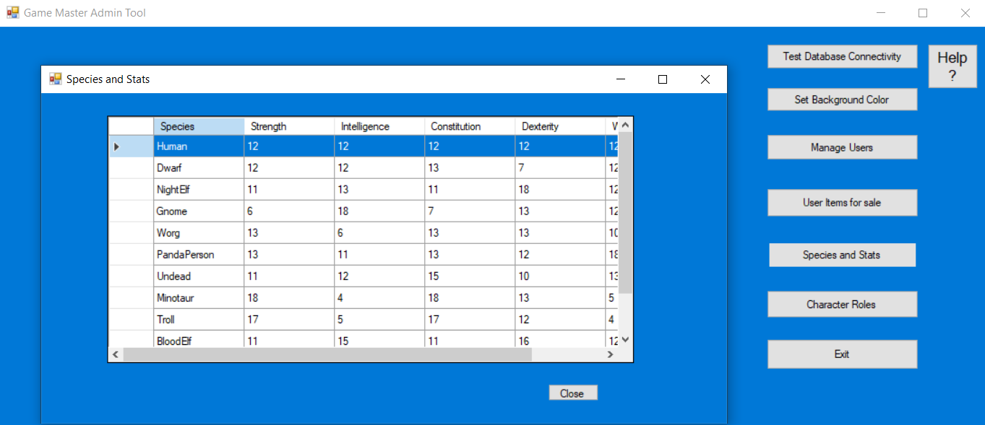
Role Playing Game Database
By KYLE Hansen

Slide 2
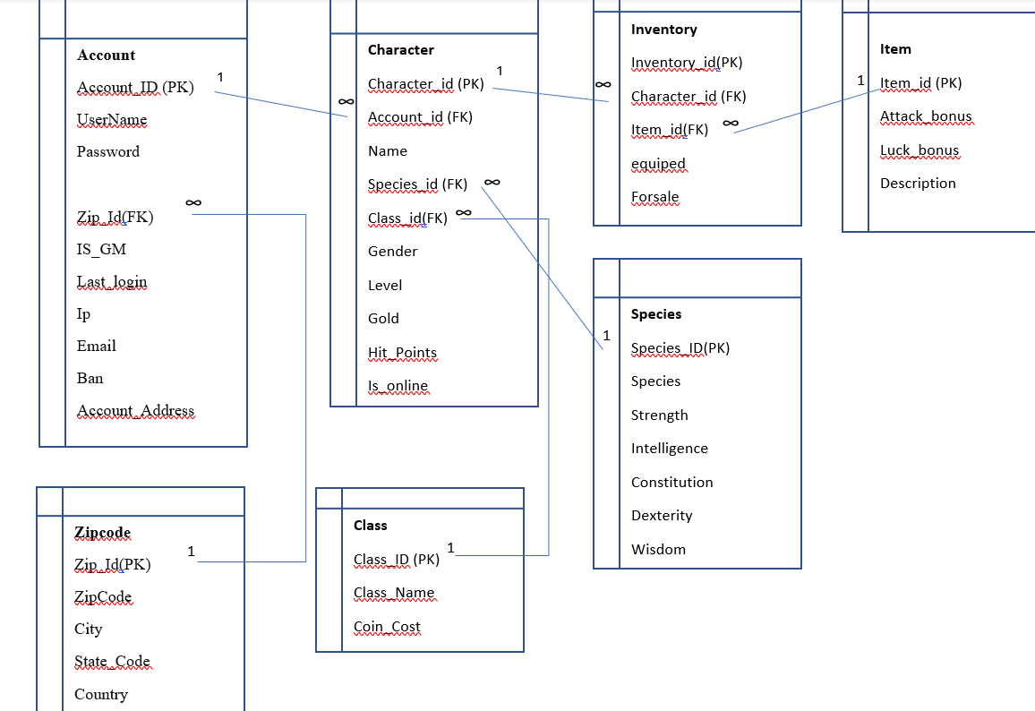
Database Diagram

Slide 3
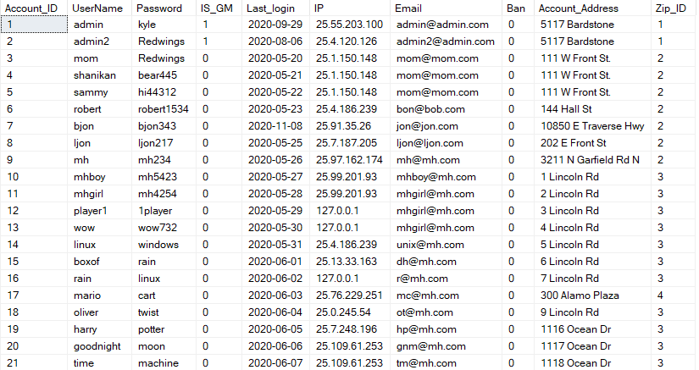
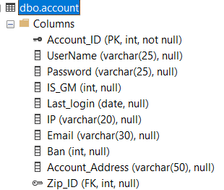
Account Table

Slide 4
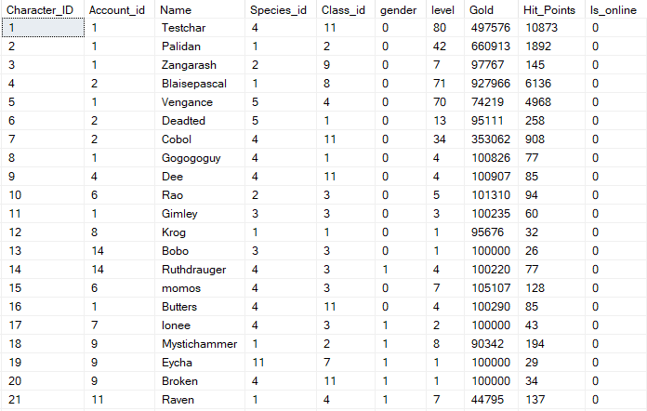
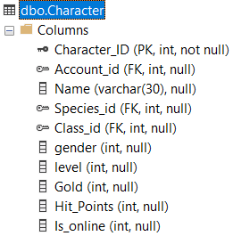
Character Table

Slide 5
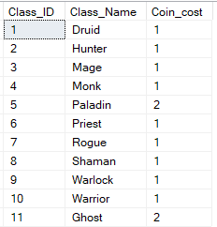
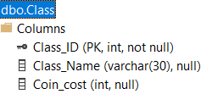
Class Table

Slide 6
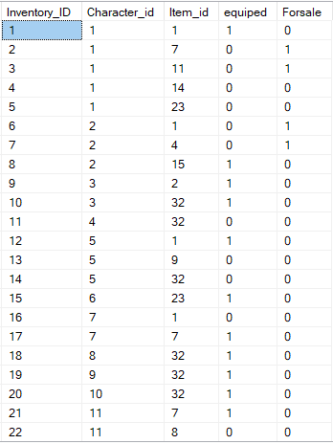
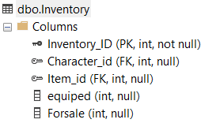
Inventory Table

Slide 7
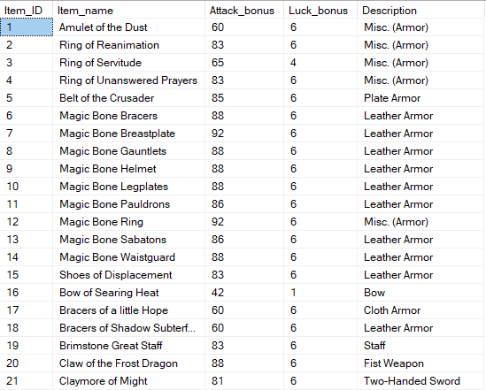
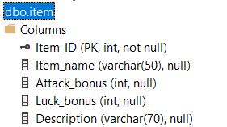
Item Table

Slide 8
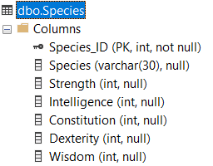
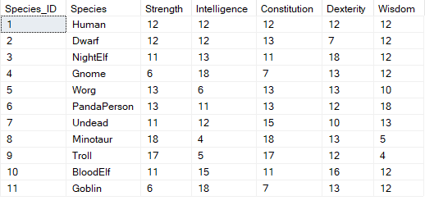
Species Table

Slide 9
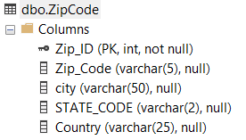
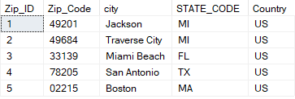
ZipCode Table

Slide 10
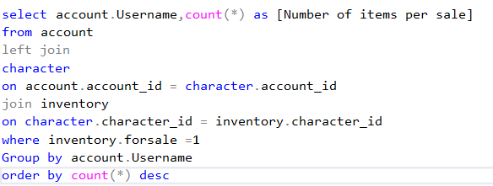
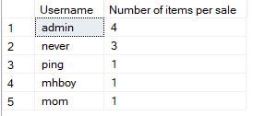
Summary Query #1
This query will determine which users are selling in-game items and sort the results by the users selling the most.

Slide 11
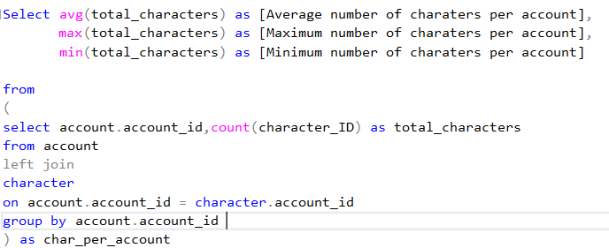
Summary Query #2
This query will get the Average, Maximum, and Minimum number of charters per account.
note: To get the values of zero correctly counted for accounts with zero characters
we must use a left join.

Slide 12
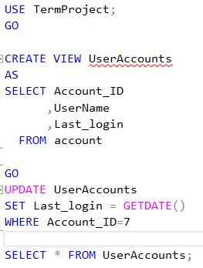
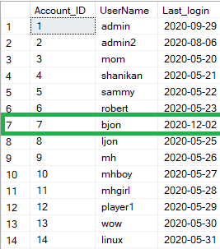
View #1
This updatable view can be used to update the last login values of accounts.

Slide 13
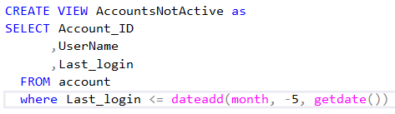

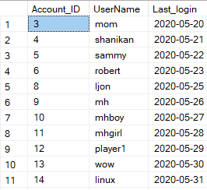
View #2
This view will list all accounts not active for 5 months or more.

Slide 14
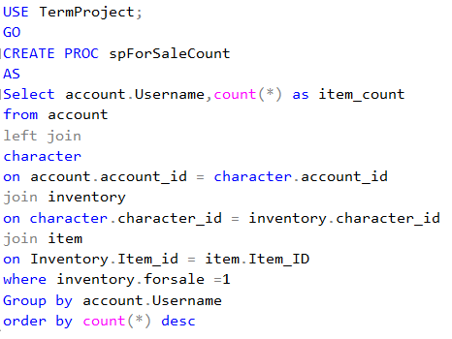

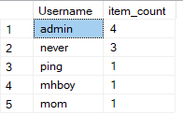
Stored Procedure #1
This stored procedure will list a count of items for sale per seller.

Slide 15
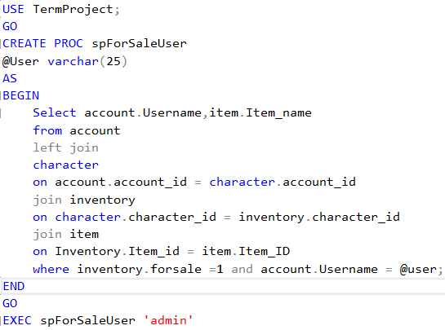
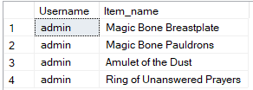
Stored Procedure #2
This procedure will take a username as a parameter and then return all the items the given user has listed for sale in the market.

Slide 16
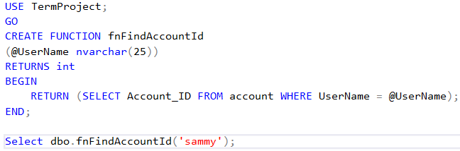

Function #1
This function will return an account ID given a username.

Slide 17
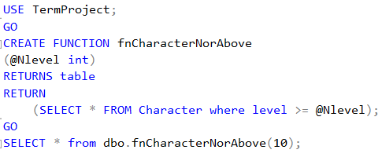
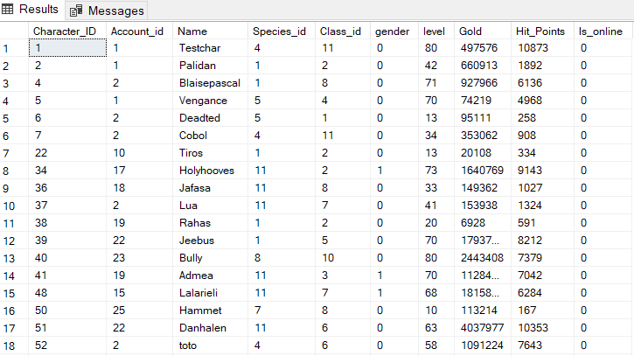
Function #2
This function will return a table containing rows of game characters at or above the value passed to the function.

Slide 18
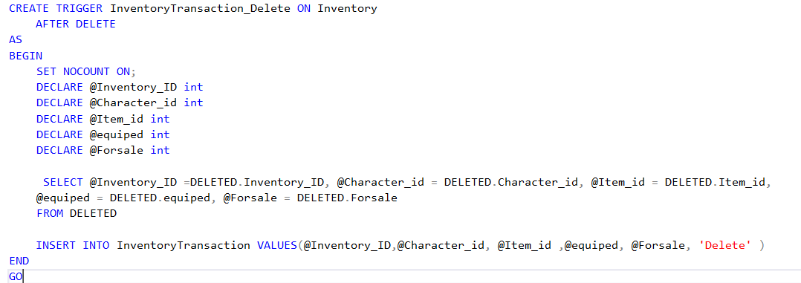
Trigger #1: This trigger will add a row to the InventoryTransaction table when a delete is preformed on the Inventory table.

Slide 19
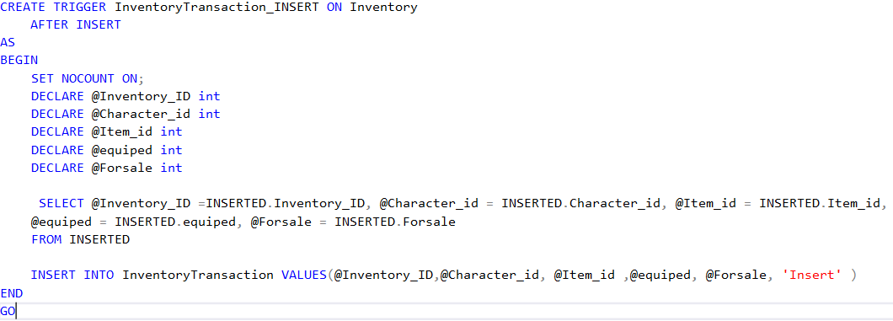
Trigger #2: This trigger will add a row to the InventoryTransaction table when an insert is preformed on the Inventory table.

Slide 20
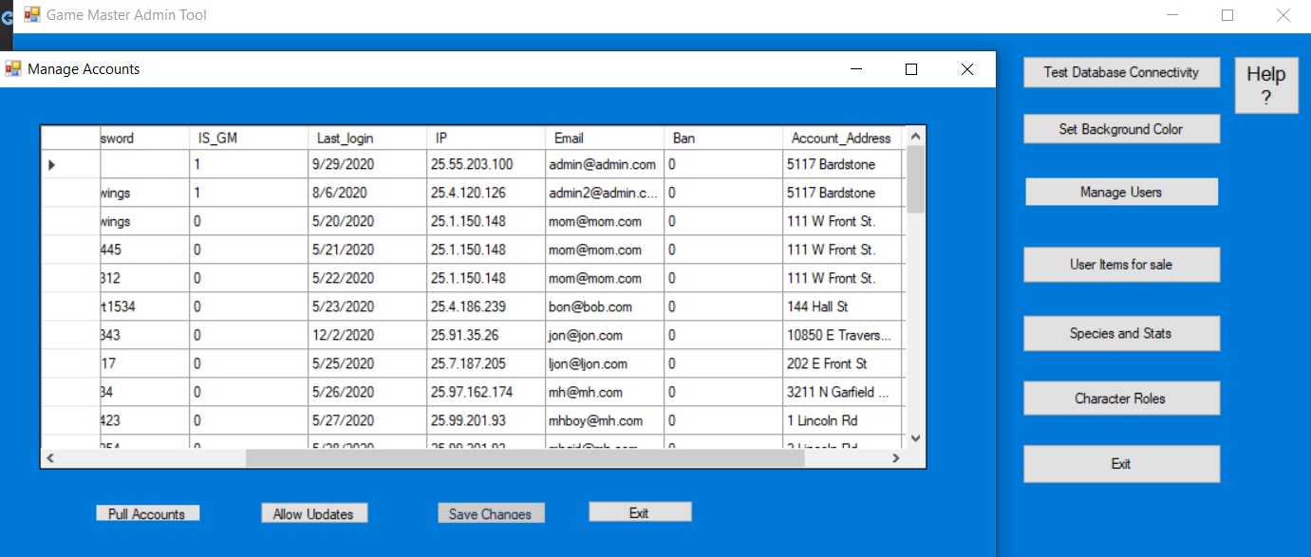
What went well
Most parts of the project went great. In fact, I had so much fun with the database that integrated the project into my Capstone project for CIT110. I wrote a front-end admin tool for the database.

Slide 21
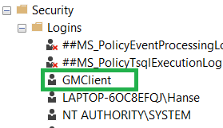
What I had problems with
Triggers were difficult for me at first. Creating an update trigger was the most difficult trigger to figure out for me.
Figuring out the settings that I needed in the database to us it via other applications. I had to make a client account with SQL server authentication and turn on SQL server authentication. For whatever reason, my SQL server defaulted to Windows authentication only.

Slide 22
What did I learn
I learned about:
SQL
Functions
Triggers
Tables
Views
Stored procedure
And much more

Slide 23
What I would like to include in future releases
I would like to include several more tables such a character location table and a monster location table. I would also like to include various functions that I can call to pull data from these tables. I will want these if I create an actual game that uses this database as a back-end.

